Slide 1

International Virtual Course 2023
‘Tackling Climate Change through Global Learning’

Slide 2

International Virtual Course
SDG 13-Climate change
UN - SDG
Funded by: Movetia and Mercator foundation, Switzerland

Slide 3




International Virtual Course (IVC) 2023 – learning objectives
You are able…
  1. To describe the impacts of climate change focusing on agro foodsystems and to develop innovative solution strategies
  2. To correctly apply virtual collaboration tools (Jam board, Zoom, Whatsapp, etc.)
  3. To collaborate effectively across cultural borders via virtual channels
  4. To strengthen the skills through international learning in digitalization and intercultural cooperation
  5. To address the global climate related and other emerging issues
  6. To enhance knowledge on climate change through lectures, case studies and discussions by international experts

Slide 4
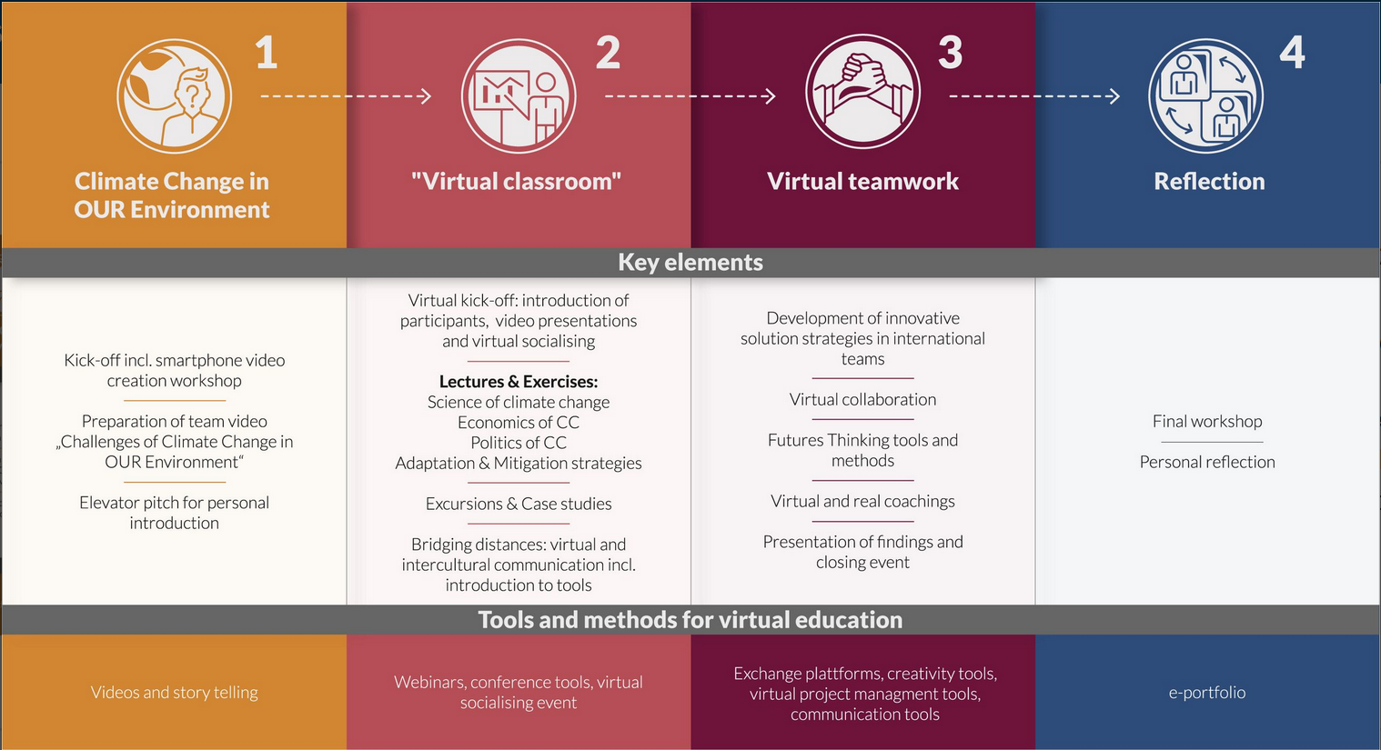
International Virtual Course 2023
4 Phases

Slide 5

International Virtual Course 2023
01/05/2023-29/07/2023 (part time)
Local perspective
Preparation of video, Climate Change in our Environment (one video per university)
01/05/23 to 01/07/23 (approx. 30h, 1day presence)
Lectures, presentations, discussions, excursions
03/07/23 to 14/07/23(approx. 40h, 2 day presence)
Virtual team work
Elaboration of innovative solution strategies in teams of 4 (India, Brazil, Switzerland & Kenya)
11/07/23 to 21/07/23(approx. 40h 1day presence)[Phase II & III run parallel]
Virtual classroom
Reflection of virtual and intercultural collaboration
  24/07/23 to 29/07/23(approx. 10h, 0.5 day presence)
Reflection
→ limited presence due to virtual tools

Slide 6
International Virtual Course 2023 Registration
  Application opens from 16/01/2023 ( Please visit the below link for application form https://www.uasbangalore.edu.in)
  Eligibility: MSc and PhD students of Agricultural Economics, Forestry and Environmental Science, Agronomy, Soil Science & Agricultural Chemistry and Crop Physiology
  Application closes on 18/02/2023
  Decision on selection 28/02/2023 → 10 students will be selected based on letter of motivation
  Requirement: Communication skills (English), interest in climate change, intercultural and virtual cooperation and knowledge on virtual tools
  Online submission of filled in application: ivss2024@gmail.com on or before 18/02/2023.
  For more details contact: Dr. K. B. Umesh, Coordinator, Dr. Mahin Sharif, Associate Coordinator and Dr. Udaykumar, Research Associate, International Virtual Course, Dept. of Agril. Economics, GKVK, Bangalore.

Slide 7
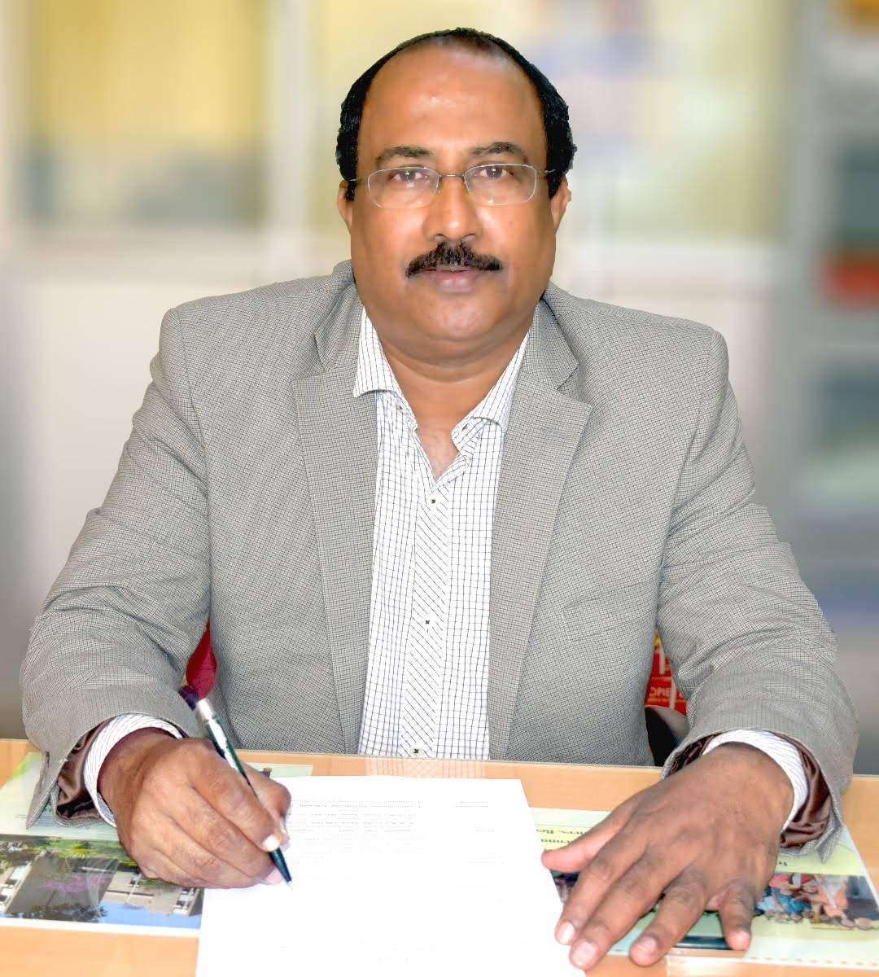
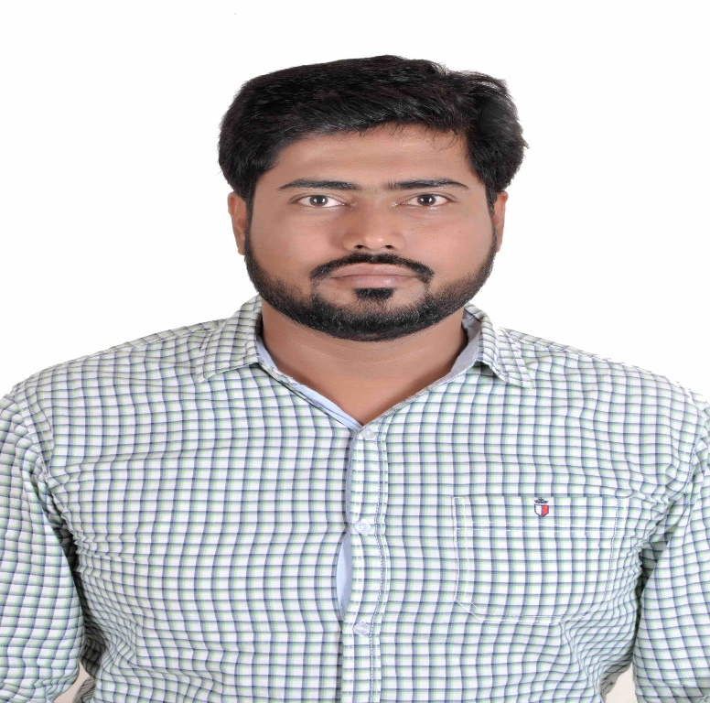
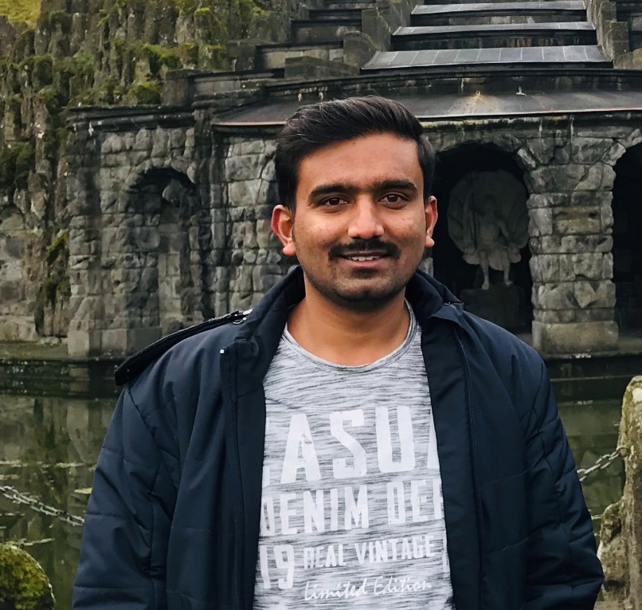
IVC Coordination Unit
Dr K B Umesh
Dr Mahin Sharif
Dr Udaykumar M S
Director of Research
Professor and Univ. Head
Department of Agricultural Economics
Co-Ordinator, International Virtual Course
Assistant Professor
Department of Agricultural Economics
Associate Co-Ordinator, International Virtual Course
Research Associate
Department of Agricultural Economics

